Slide 1
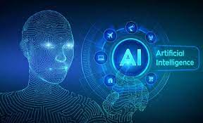
AI Demystified

Slide 2
Definitions
Intelligence: The capacity to learn and solve problems
Artificial Intelligence : A simulation of human intelligence by machines
ability to mimic or duplicate the function of human brain
AI deals with the automation of intelligent behavior

Slide 3
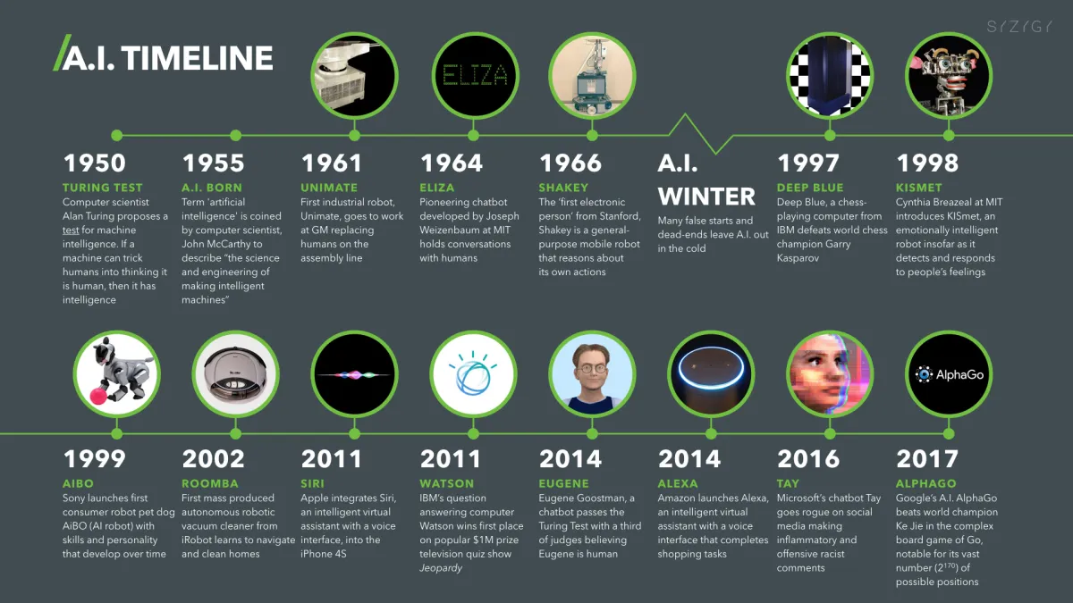

Slide 4
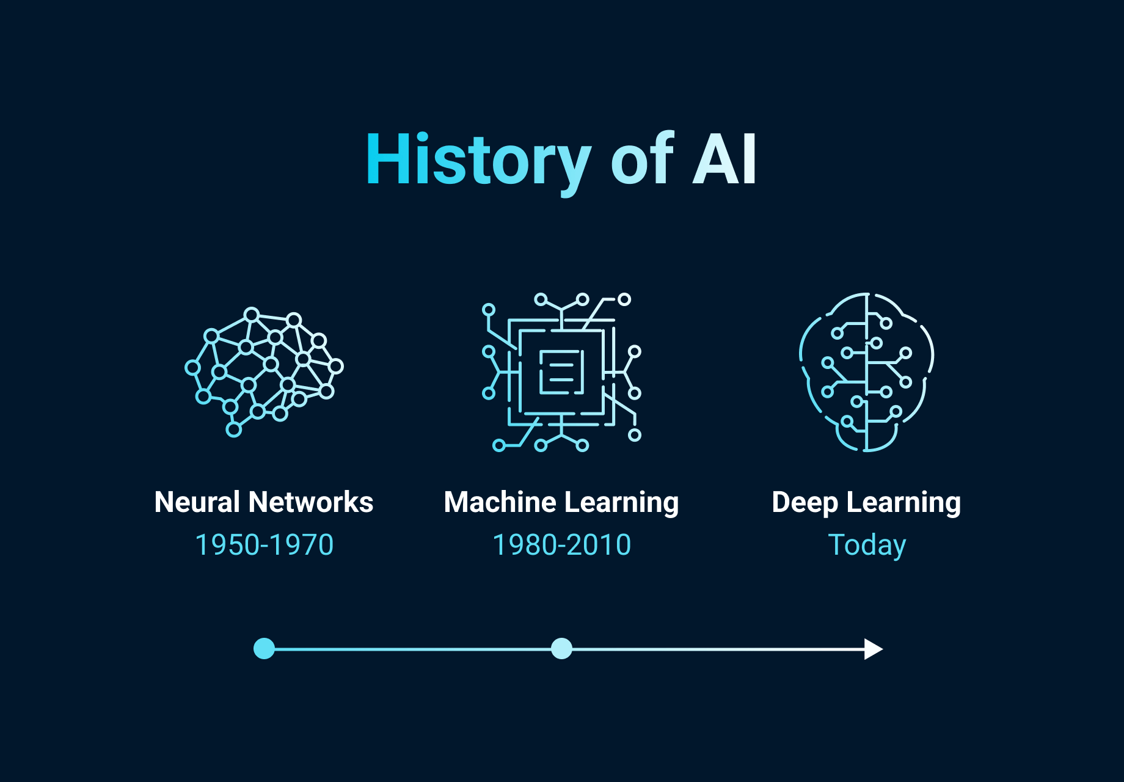

Slide 5
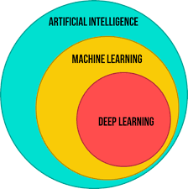
Artificial Intelligence, Machine Learning & Deep Learning

Slide 6
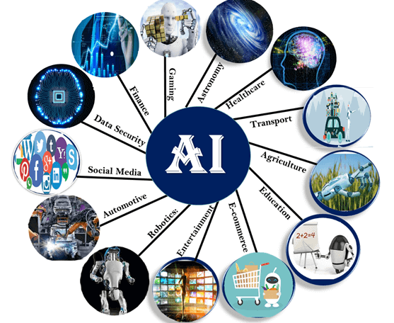
Applications of AI

Slide 7
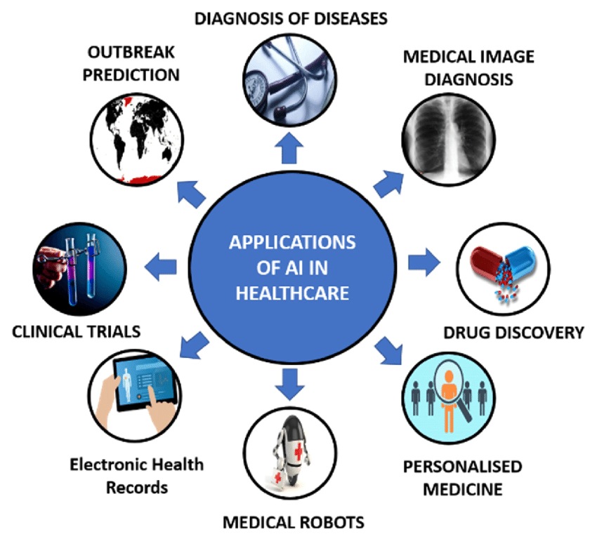

Slide 8
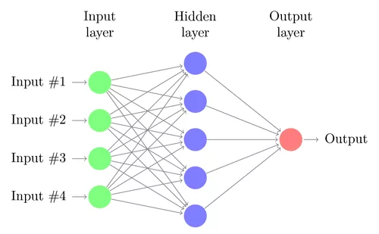
A simple neural network

Slide 9
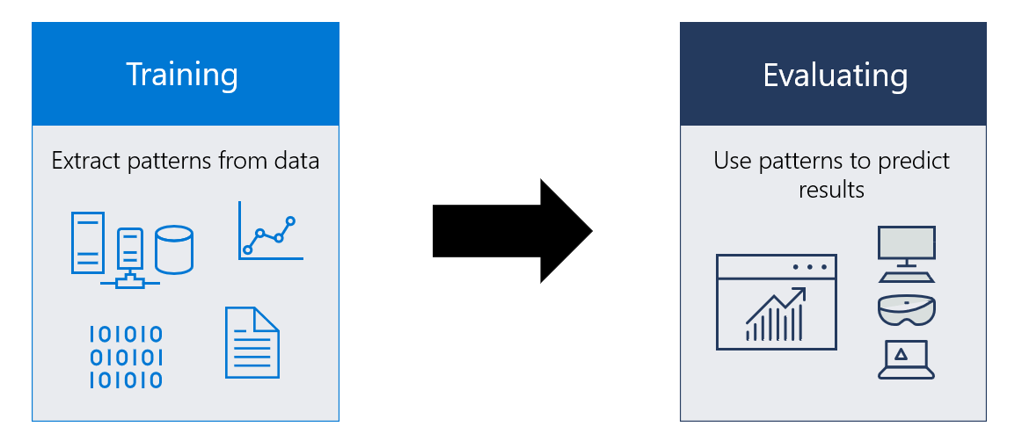
Machine Learning Model

Slide 10
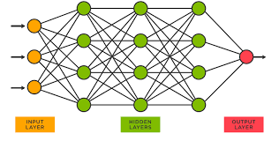
Deep Neural Networks

Slide 11
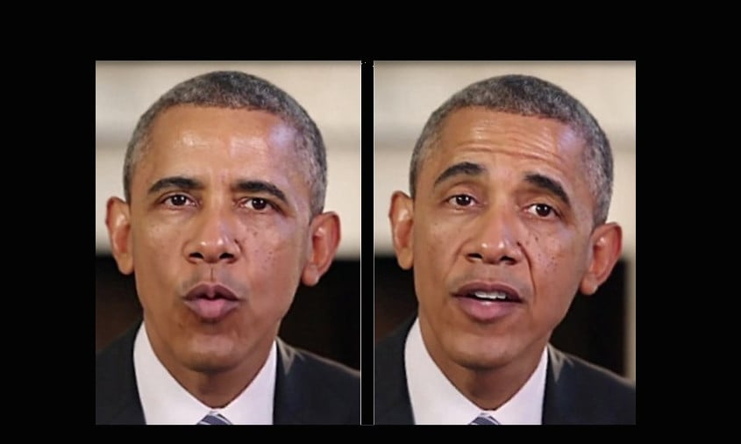
Recent Sensations in the field of AI
DeepFakes

Slide 12
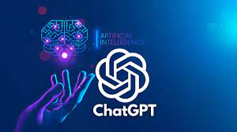
ChatGPT

Slide 13
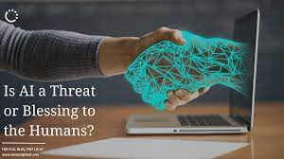
Future of AI

